Slide 1
PEP Input Class
Presented By
Kanika Sharma

Slide 2
Topics to be covered…
Data types:
built in ,
derived,
user defined with access specifiers
range formulae

Slide 3
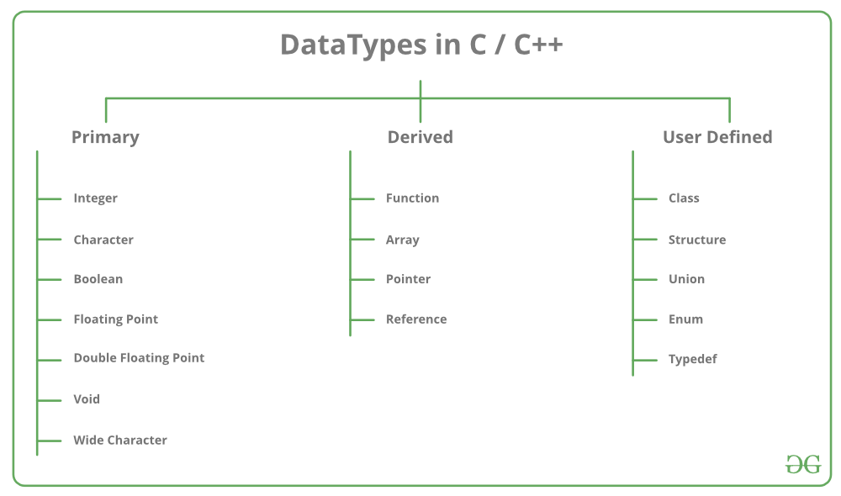

Slide 4
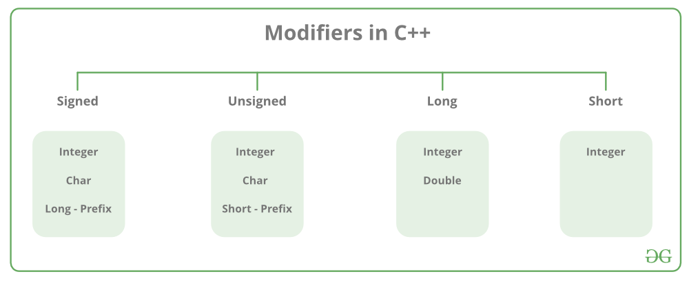
Data type modifiers

Slide 5
Getting range of data type using macros
#include<iostream>
#include<limits.h> // for int,char macros
#include<float.h> // for float,double macros
using namespace std;
int main()
{
cout << "char ranges from : " << CHAR_MIN << " to " << CHAR_MAX;
cout << "\n\nshort char ranges from : " << SCHAR_MIN << " to " << SCHAR_MAX;
cout << "\n\nunsigned char ranges from : " << 0 << " to " << UCHAR_MAX;

Slide 6
cout << "\n\n\nshort int ranges from : " << SHRT_MIN << " to " << SHRT_MAX;
cout << "\n\nunsigned short int ranges from : " << 0 << " to " << USHRT_MAX;
cout << "\n\nint ranges from : " << INT_MIN << " to " << INT_MAX;
cout << "\n\nunsigned int ranges from : " << 0 << " to " << UINT_MAX;
cout << "\n\nlong int ranges from : " << LONG_MIN << " to " << LONG_MAX;
cout << "\n\nunsigned long int ranges from : " << 0 << " to " << ULONG_MAX;
cout << "\n\nlong long int ranges from : " << LLONG_MIN << " to " << LLONG_MAX;
cout << "\n\nunsigned long long int ranges from : " << 0 << " to " << ULLONG_MAX;
cout<<“Float value range”;
cout << "\n\n\nfloat ranges from : " << FLT_MIN << " to " << FLT_MAX;
cout << "\n\nnegative float ranges from : " << -FLT_MIN << " to " << -FLT_MAX;
cout << "\n\ndouble ranges from : " << DBL_MIN << " to " << DBL_MAX;
cout << "\n\nnegative double ranges from : " << -DBL_MIN << " to " << +DBL_MAX;
return 0;
}

Slide 7
Calculating range using formula

Slide 8
Steps to calculate range
Calculate total number of bits by multiplying size of with 8 (say n)
Calculate -2^(n-1) for minimum range
Calculate (2^(n-1))-1 for maximum range

Slide 9
Basic program
#include <iostream>
#include<cmath>
using namespace std;
int main()
{
int x = sizeof(char)*8;
int min=-pow(2,x-1);
int max=(pow(2,x-1)-1);
cout<<"minimum range is"<<min<<"maximum range is"<<max; return 0;
}

Slide 10
Another Approach
#include <iostream>
#include <cmath>
#define SIZE(x) sizeof(x) * 8
using namespace std;
void getRange(string type, int n) {
if(type.compare("SIGNED") == 0) {
int min = pow(2, n - 1);
int max = pow(2, n - 1) - 1;
cout << "Range from " << (-1) * min << " to " << max;
}else{
int range = pow(2, n )-1;
cout << "Range from 0 to " << range << endl;
}
}
int main() {
cout << "For Signed int: ";
getRange("SIGNED", SIZE(int));
cout << "For Signed float: ";
getRange("SIGNED", SIZE(float));
cout << "For Unsigned int: ";
getRange("UNSIGNED", SIZE(unsigned int));
cout << "For Unsigned short: ";
getRange("UNSIGNED", SIZE(unsigned short int));
cout << "For Signed char: ";
getRange("SIGNED", SIZE(char));
return 0;
}

Slide 11
Predict the output

Slide 12
Example 1
#include<iostream>
using namespace std;
int main()
{
char k='i';
cout<<k+'h';
return 0;
}

Slide 13
Example 2
#include<iostream>
using namespace std;
int main()
{
char k='i';
cout<<k+"hello";
return 0;
}

Slide 14
Example 3
// Assume that integers take 4 bytes.
#include<iostream>
using namespace std;
class Test
{
int i;
int k;
float p;
};
int main()
{
cout << sizeof(Test);
return 0;
}

Slide 15
Answers
209
No output
12

Slide 16
Thanks.

